Slide 1


"A Field of Dreams"? Digital Media Spending in the NonProfit Sector - Results of a Landmark Study
&
The Nature Conservancy Case Study
Paul Clolery, The NonProfit Times
Roger Hiyama, Wiland
Jessica Kirsche Morrow, The Nature Conservancy

Slide 2

Thank You to our Webinar Sponsor
We thank our sponsor, Oracle NetSuite, a financial management system for nonprofits of all sizes. Built specifically for nonprofits, their system helps improve efficiency, create dollars-to-outcomes visibility, and boost mission impact. You can learn more about their Social Impact program which offers donations and pro bono services to nonprofits at www.netsuite.com/socialimpact

Slide 3


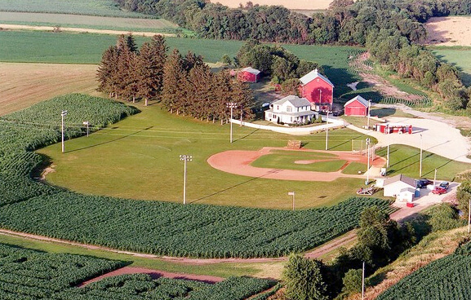
"If you build it, he will come." With these words, Iowa farmer Ray Kinsella (Kevin Costner) is inspired by a voice he can't ignore to pursue a dream he can hardly believe. Supported by his wife Annie (Amy Madigan), Ray begins the quest by turning his ordinary cornfield into a place where dreams can come true.

Slide 4
If you build it (your website) …
… they (the donor) will come.

Slide 5
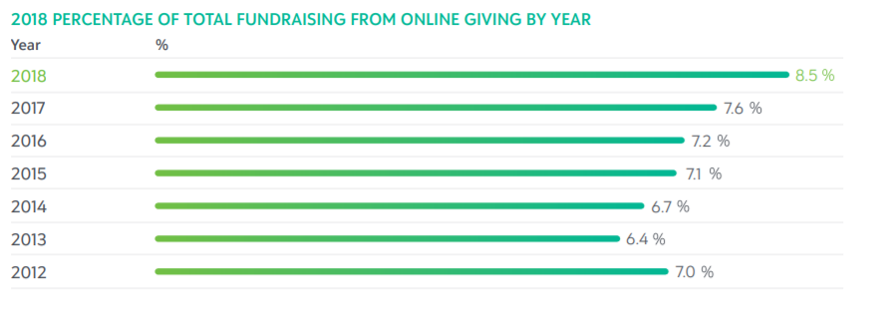
Online Giving – Blackbaud’s 2018 Charitable Giving Report
Source: Blackbaud’s 2018 Charitable Giving Report

Slide 6
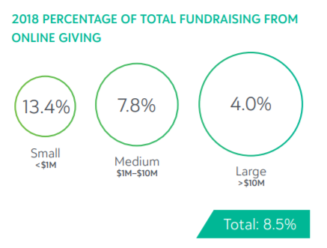
Online Giving – Blackbaud’s 2018 Charitable Giving Report
Source: Blackbaud’s 2018 Charitable Giving Report

Slide 7



Our Digital Media Spending Survey
Born from a discussion at Bridge Conference in Aug 2018
Much has been written and researched on online giving habits
Not much has been written about digital media spend
Commissioned the Nonprofit Digital Media Spending Survey

Slide 8
About the Study
This study of digital media utilization by nonprofit organizations was conducted during June 2019 by Campbell Rinker on behalf of Wiland in cooperation with The NonProfit Times.
Two separate groups of 5,000 of The NonProfit Times subscribers known to work at a nonprofit organization were selected at random and invited to participate online with email invitations. 225 subscribers answered, for a 2.25% response rate.
Results were audited during fielding to ensure that participation was representative of the nonprofit sector as a whole, on the basis of organization revenue and sector representation.
This level of response delivers a ±6.5% margin of error at the 95% confidence level.
A separate group of Wiland’s larger clients were also surveyed (17% response rate and are shown as blue in slides for comparison purposes)
Text in slides relates to NPT subscriber respondents

Slide 9
Survey Findings

Slide 10
Organizational Dynamics

Slide 11

Organization Scope
Just over a third of respondents represented either local or regional nonprofits (35%). Local organizations were likelier to report lower revenue.
One in six were national charities (16%).
One in seven was International (14%).
47%
37%
13%
3%
Q. Which of the following best describes your organization’s/ chapter’s scope of influence?

Slide 12

Non-Profit Sector
Human service groups are most represented, as they are in the NP sector at large, especially among human services and health & medical.
Smaller groups were more likely to focus on arts and culture and progressive advocacy.
33%
40%
23%
7%
7%
20%
17%
7%
17%
7%
17%
7%
Q. What outcomes does your organization focus on?

Slide 13
Total Revenue from Last Reporting Period
93%
About half of the nonprofits answering this study earned under $2 Million in revenue annually.
About one in three earned from $2 million to $10 million.
About a quarter earned over $10 million yearly.
Q. Please estimate your organization’s total revenue from its last reporting period.

Slide 14
Organization Represents a Chapter
Most participants represented a distinct organization that was not a chapter of a larger group.
Q. Does your organization represent a chapter of a larger group?

Slide 15
Media Usage in Organizations

Slide 16
Responsibility for Digital Marketing
Responsibility for digital marketing is most likely to rest with the marketing communications department.
Secondarily, this responsibility falls to the development, fundraising, advancement or membership.
About a third of organizations split digital marketing responsibility across multiple groups.
60%
43%
13%
3%
7%
13%
Q. Which department is responsible for digital marketing in your organization?

Slide 17
Division of Responsibilities for Digital Media
About a third of organizations split digital marketing responsibility across multiple groups.
Q. In your organization, please note if these departments focus on digital media strategy, execution, or both?

Slide 18
Digital Media Spending Objectives
Respondents rarely pursue a single objective with their digital media spending, with an average of 2.3 goals.
The most common goals were fundraising and branding/ education (72% overall for each).
Larger organizations tend to focus first on branding/ education before fundraising, while smaller organizations are more apt to pursue fundraising first.
Advocacy was cited as a third-level goal.
87%
87%
27%
47%
27%
10%
Q. What objective(s) does your organization pursue with its online media spending?

Slide 19
Primary Objective for Digital Media
About four in ten respondents said branding was their first goal in using digital media, and about the same proportion said it was fundraising.
20%
57%
3%
3%
10%
7%
Q. Which of these objectives would you say is primary?

Slide 20
Digital Fundraising as Key Initiative
60%
45% of respondents said “Growing digital fundraising is a key initiative of our organization” was either somewhat or completely accurate.
20%
13%
3%
3%
0%
Q. Please rate how accurately or not this statement describes your organization: “Growing digital fundraising is a key initiative in our organization.”

Slide 21
Traditional Media Spending Objectives
As with digital media, respondents saw fundraising and branding equally as the main goals in traditional media.
The reasons for pursuing a traditional media strategy follow the same sequence as with digital media.
97%
60%
20%
27%
23%
Q. What objective(s) does your organization pursue with its offline media spending (e.g. direct mail, telemarketing, print, outdoor)?

Slide 22
Primary Objective for Traditional Media
Most respondents say their chief goal in using traditional media is fundraising.
The prominence of branding and education as a goal of digital media, where it is not a goal of traditional media, is striking and statistically significant.
83%
3%
3%
10%
Q. Which of the objectives above would you say is primary?

Slide 23
Media Budgeting and Trends

Slide 24
Annual Digital Media Budget
Q. What is your organization’s approximate annual budget for spending in the following online media categories?
Notes:
Spending by smaller organizations in digital media rose substantially from 2018 to the present year.
The areas of digital media seeing the greatest increases were in online display, email, and Other (often website).
No area saw a reduction in the amount of budget invested.
The amounts invested by smaller organizations are small compared to the possible investment in keeping 1.5 to two staff members who are charged with maintaining digital systems.

Slide 25
Annual Budget for Traditional Media
Q. What is your organization’s approximate annual budget for spending in the following traditional media categories?
Notes:
In contrast to the large increases seen in several areas of digital media, most traditional media channels saw very modest budget changes among smaller organizations.
Events were generally the dominant traditional media budget item for smaller organizations.

Slide 26
Overall Changes in Media Spending ‘18-’19
Overall media spend increased by about 20 percent.
Digital media spend increased by 60 percent.
Digital media represents 30 percent of all media spending.

Slide 27
Annual Digital Media Budget
$157,214
Wiland data shown in blue
$124,092
$143,133
$112,273
$103,989
$90,500
$90,718
$83,563
Q. What is your organization’s approximate annual budget for spending in the following online media categories?
Notes:
The same pattern of strong increases in spending on digital media channels from 2018 to the present year also emerged for larger organizations.

Slide 28
Annual Budget for Traditional Media
$7.1MM
$7.3MM
$609K
Wiland data shown in blue
$438K
$329K
$325K
$350K
$255K
$232K
$179K
$191K
$168K
$91K
$82K
Q. What is your organization’s approximate annual budget for spending in the following traditional media categories?
Notes:
And, echoing the results for smaller organizations, any increases in budget allocation for traditional media were relatively modest.
Direct mail was by far the dominant traditional media budget item for larger organizations, outpacing events by five to one.
Canvassing, or face-to-face marketing, has emerged as a significant budget area for larger organizations.

Slide 29
Overall Changes in Media Spending ‘18-’19
Wiland data shown in blue
$9.60MM
Overall media spend increased by just three percent.
Digital media spend increased by 120 percent (small numbers).
Even at this higher level, digital media represents just seven percent of all media spending by larger organizations.
Digital media spend only 5% of total media spend for larger Wiland clients
$9.12MM
$8.95MM
7.3% increase
$8.52MM
7% increase
$479K
$428K
12% increase
Notes:
Proportionally, smaller organizations spend four times more on digital media than their larger organization cousins do.

Slide 30
Change Seen in Digital Media Spending ‘18-’19
The researchers categorized the budget reported in 2019 as less, the same, or more than was reported for 2018.
The missing percentage means no comparison was possible.
Despite the increase in average digital media spend across the sector, just 13% were found to have reported higher spending, and a quarter spend the same amount.

Slide 31
Change Seen in Traditional Media ‘18-’19
By the same measure, a much higher proportion reported spending the same in 2019 on traditional media channels as they had in 2018.

Slide 32
Unmasking Digital Strategies

Slide 33
Google Grants
About half of responding organizations that used online paid search accepted a Google Grant.
Most accepted the smaller monthly Google Grant amount.
These results are anecdotal given the low number of respondents.
Q. Does your organization accept a Google Grant?

Slide 34
Online Display Ad Budget Breakout
The largest share of online display advertising goes to pure acquisition.
Larger organizations put more into remarketing display ads to website visitors, while smaller orgs. put more into co-targeting.
46%
25%
14%
15%
Q. Approximately what percentage of your online display ad budget is dedicated to each of the following?

Slide 35
Social Media Spending Breakout
86%
Facebook is by far the dominant social media buy for both larger and smaller organizations.
8%
6%
Q. About what percentage of your social media spending goes toward…?

Slide 36
Sourcing Methods for Pure Acquisition Prospects
Large and small organizations tend to pursue very different sourcing methods for pure acquisition.
The larger groups seem to do their own work, while the smaller groups seem to rely more on support from their ad platform.
80%
40%
30%
0%
Q. For pure acquisition, how are the prospects sourced?

Slide 37
Who Handles Audience Sourcing/Targeting?
It is most common for internal staff to handle audience sourcing and targeting, and these duties are typically split between the functions of branding and development.
This is consistent with earlier results about departmental responsibility for digital media.
63%
30%
57%
7%
47%
3%
Q. Who makes the determination of which audiences are sourced and targeted?

Slide 38
Ad Trading Platforms Used for Online Display
78%
Consistent with the strong use of Facebook for social media ads, the Facebook Ads Manager is the most use ad trading platform, followed by Google’s Doubleclick tool.
Platforms from MS, Adobe and Oath made a small showing.
44%
33%
17%
0%
Q. Please select any of the following ad trading platforms your organization uses for its online display advertising.

Slide 39
Sources of Unattributed Digital Revenue
80%
70%
A strong six in ten nonprofits reported receiving unattributed revenue from Amazon Smile program and from Facebook.
27%
23%
13%
17%
Q. Does your organization receive unattributed revenue from…?

Slide 40
Methods Used for Attribution
Eight in ten smaller nonprofits, and six in ten nonprofits with over $2 million in revenue, do not use any method to attribute donors and revenue to their sources.
47%
37%
27%
27%
17%
17%
Q. Which method(s), if any, does your organization use to attribute donors and revenue to a source channel?

Slide 41
Nonprofit Staffing for Digital Media

Slide 42
Staff Used to Implement Digital Strategy
90%
Most of the nonprofits responding to this study used in-house staff to pursue their digital media strategy.
27%
27%
27%
27%
20%
20%
Q. What human resources does your organization use to implement its digital marketing strategy?

Slide 43
Number of In-House Digital Marketing Staff
Full-time, 6.0
Counting each part-time staffer as half time, this study suggests that smaller nonprofits have about 1.9 FTE positions on staff to implement digital media strategy.
Larger nonprofits have about 2.75 FTE positions on staff.
Part-time, 2.0
Q. If you selected in-house staff above, how many people work in-house to support your digital marketing efforts?

Slide 44
Seeding the “Field of Dreams”

Slide 45
Future Digital Media Spending
Nearly half of respondents say their organization will spend the same on digital media in 2020 as they did during 2019. Few said they would spend less.
Larger entities were most likely to say they would increase by up to 10% in 2020.
About one in five organizations say they’ll boost digital media spending by over 10%.
43%
23%
23%
10%
0%
0%
0%
Q. Generally, what do you see your organization spending on digital media in the next calendar or fiscal year?

Slide 46
Obstacles to Moving Budget to Digital
Most NPOs cite budget limitations when considering shifting to digital strategies.
A secondary reason cited by smaller NPOs is that they simply don’t know where to start or need experienced staff members.
30%
26%
30%
11%
4%
4%
Q. What obstacles does your organization face in shifting budget dollars from offline to online media?

Slide 47

Case Study

Slide 48

We connect with people who care about the environment and share our values, to enable them to participate in making a difference.

Slide 49
Why We Do It
The Dollars and Cents

Slide 50
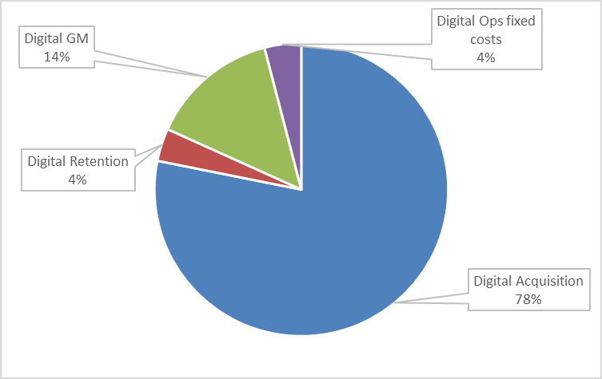
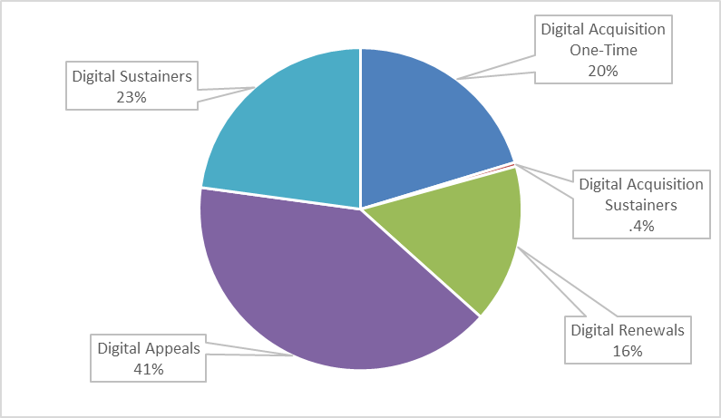
Investment Breakout
FY19 Expenses
FY19 Revenue

Slide 51
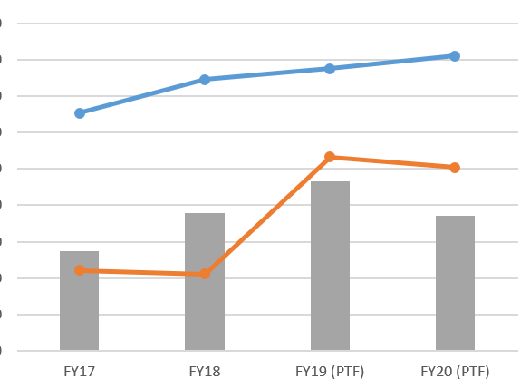
YOY Investment
Spend
Revenue
Unique Donors
4%
4%
14%
-1%
17%
-.5%
38%
23%
-20%

Slide 52
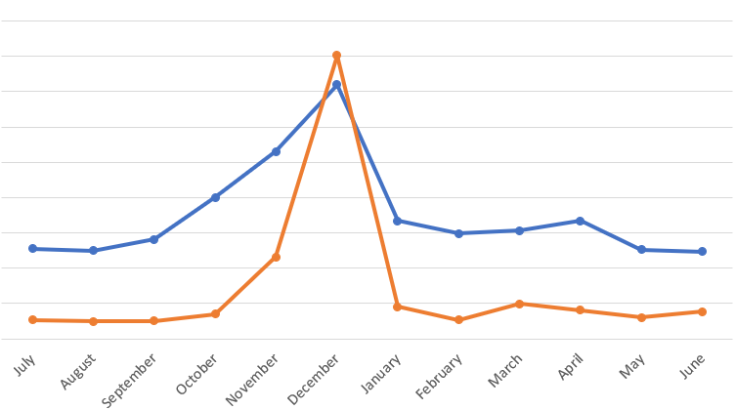
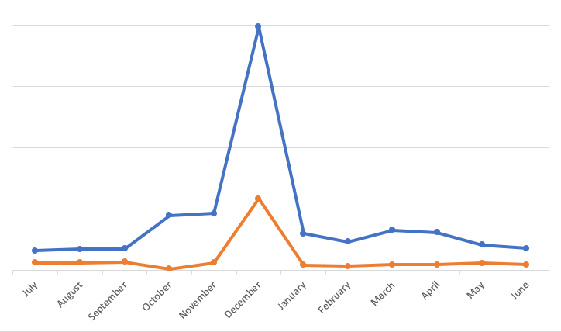
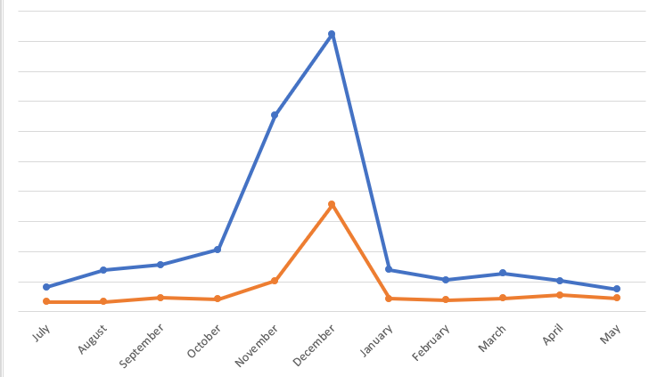
Acquisition Investment vs. Unsourced Revenue
FY17
FY18
Spend
Revenue
FY19

Slide 53
How We Do It
The Team, The Strategies, The Tactics

Slide 54
You Can’t Spell “Digital Fundraising” without FUN
Who is DigiFun?
Acquisition
Retention
This is what I do!
Direct Fundraising
Lead Generation
Engage, Cultivate,
Retain, Upgrade

Slide 55
You Can’t Spell “Digital Fundraising” without FUN
How We Do It
Nature.org
Email
(calendar & lifecycle)
Search Engine Marketing
Display Ads
(prospecting & retargeting)
Social Media
(paid prospecting & retargeting; organic posts)
SMS

Slide 56
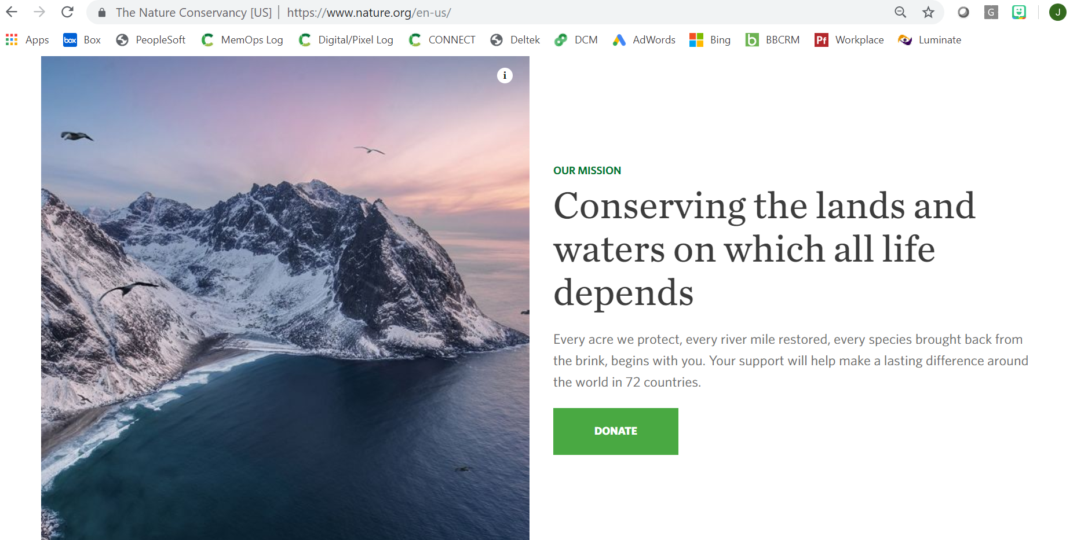


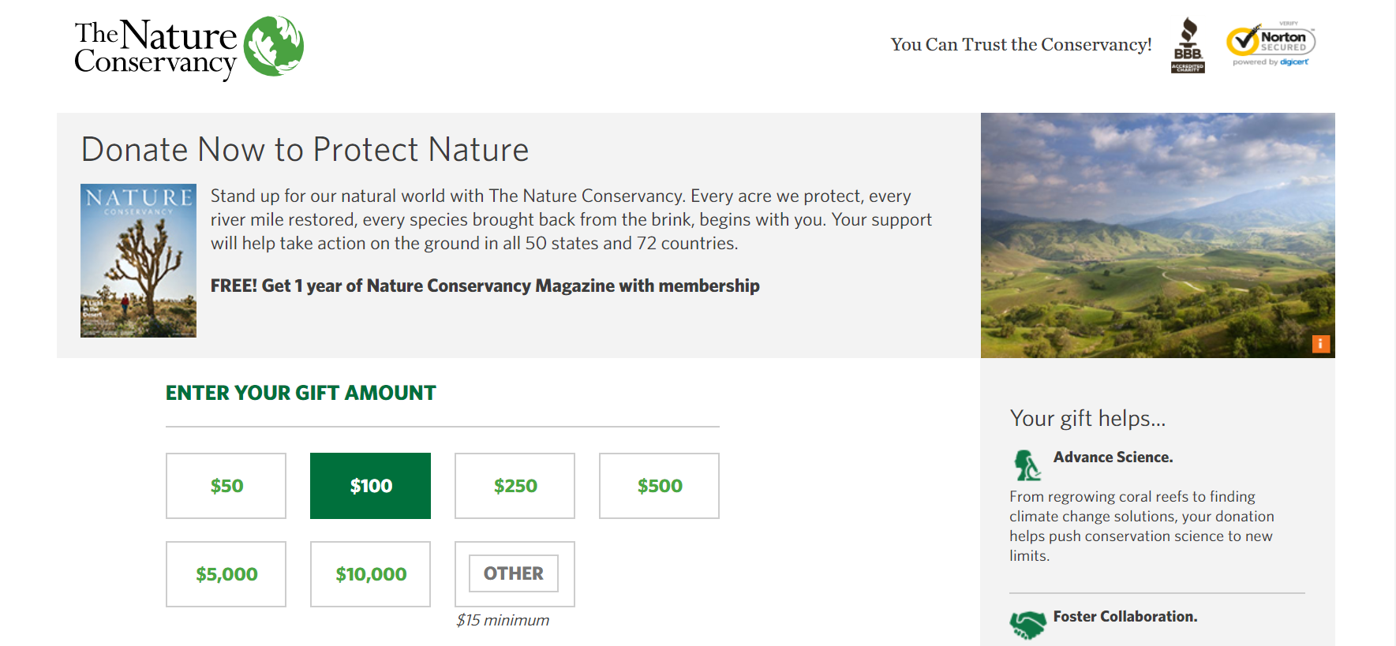
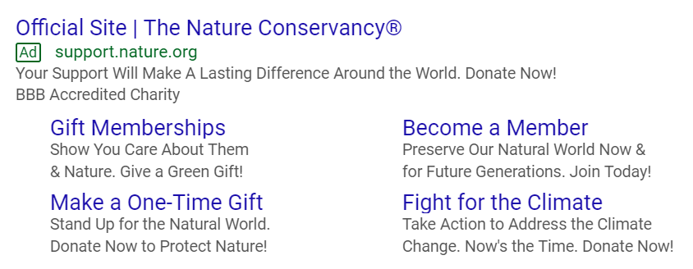
Unknown Prospect Journey

Slide 57
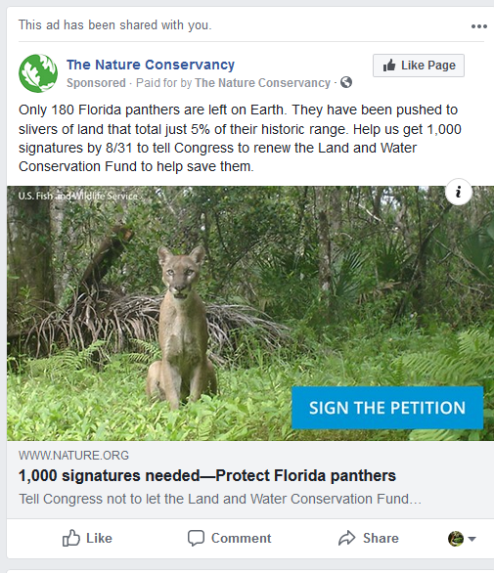
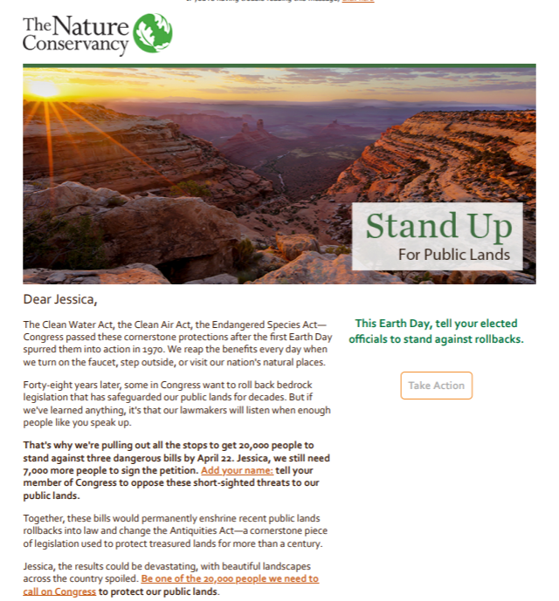
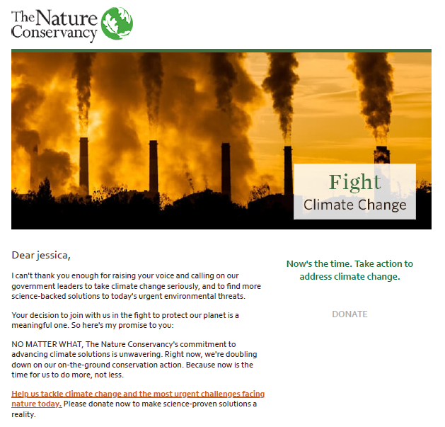
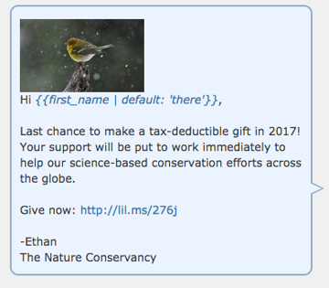
Lead Generation and Nurture Journey

Slide 58
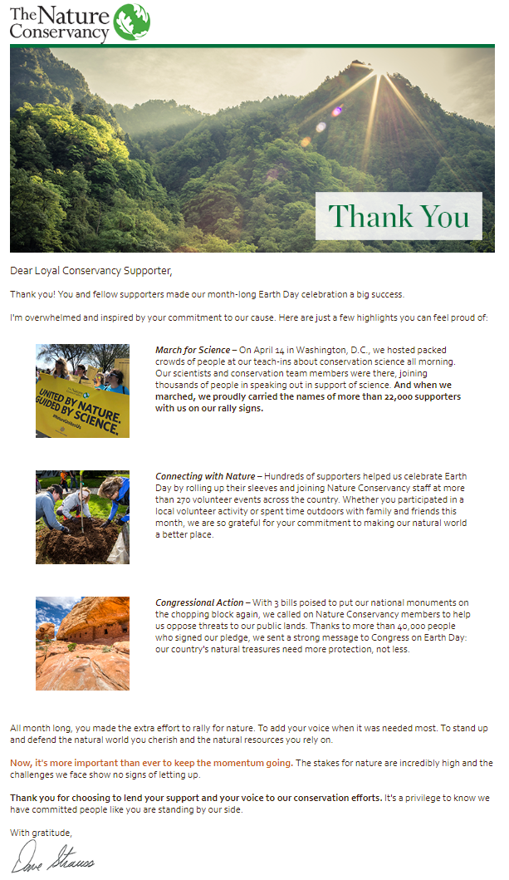
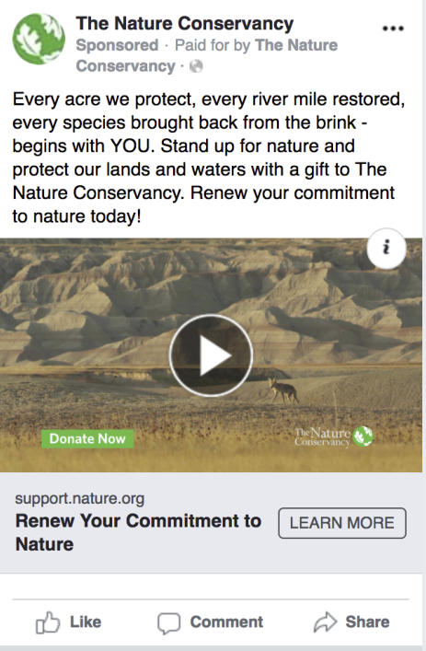

Active Donor Journey

Slide 59


Digital Creative Strategy

Slide 60
Cross-Channel Journeys
Offline Channels
Direct Mail
Telemarketing
Face-to-Face

Slide 61
Lead Generation and Nurture Journey

Slide 62

Lead Generation and Nurture Journey
Telemarketing Call

Slide 63
Active Donor Journey

Slide 64

Active Donor Journey

Slide 65
How We Measure It
The Importance of Attribution

Slide 66
First Touch Attribution

Slide 67
First Touch Attribution
Campaign X
First Touch Attribution:
12
Last Touch Attribution:
1

Slide 68
Last Touch Attribution

Slide 69
Multi-Touch Attribution
35%
10%
15%
40%

Slide 70
What can you start doing TOMORROW?
Display Ads for Cold Prospecting
Facebook doesn’t have to be your only option
Tailor Creative to your Audience
Find the balance between “One Size Fits All” and Personalization
Work with your Offline Team
Direct Mail + Display or RSLA
Measure Attribution to Manage Your Digital Media Investments

Slide 71


Thank You to our Webinar Sponsor
We thank our sponsor, Oracle NetSuite, a financial management system for nonprofits of all sizes. Built specifically for nonprofits, their system helps improve efficiency, create dollars-to-outcomes visibility, and boost mission impact. You can learn more about their Social Impact program which offers donations and pro bono services to nonprofits at www.netsuite.com/socialimpact
Thank You to our Speakers
Paul Clolery
Vice President, Editor in Chief
ednchief@nptimes.com
Jessica Kirsche Morrow
Digital Marketing Manager
jessica.kirsche@tnc.org
Roger Hiyama
SVP, Client Services
rhiyama@wiland.com

